Slide 1

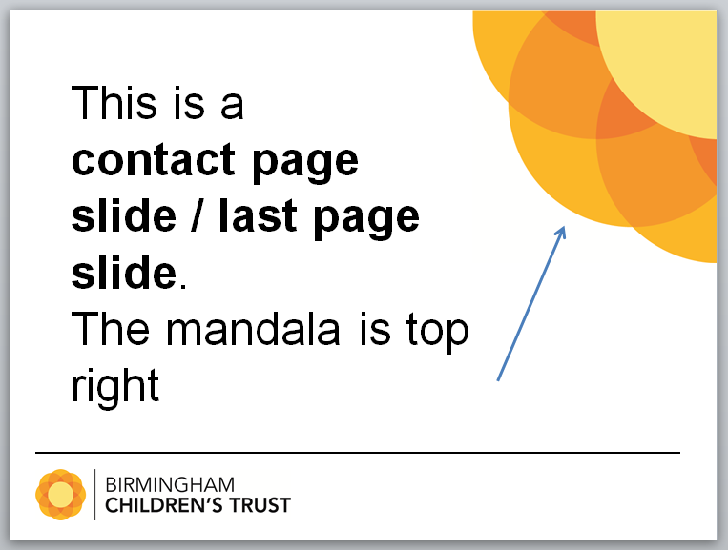
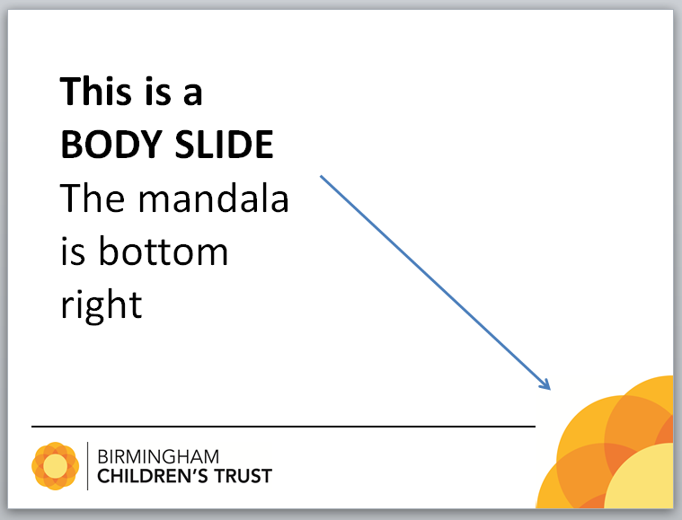
THIS IS A GUIDANCE SLIDE
PLEASE DELETE IN FULL FROM YOUR PRESENTATION

Slide 2
TITLE OF PRESENTATION (Arial 36 Bold)
Presenter(s)
Date
Location
(Arial 18 bold) Please make sure you keep the text in this box

Slide 3
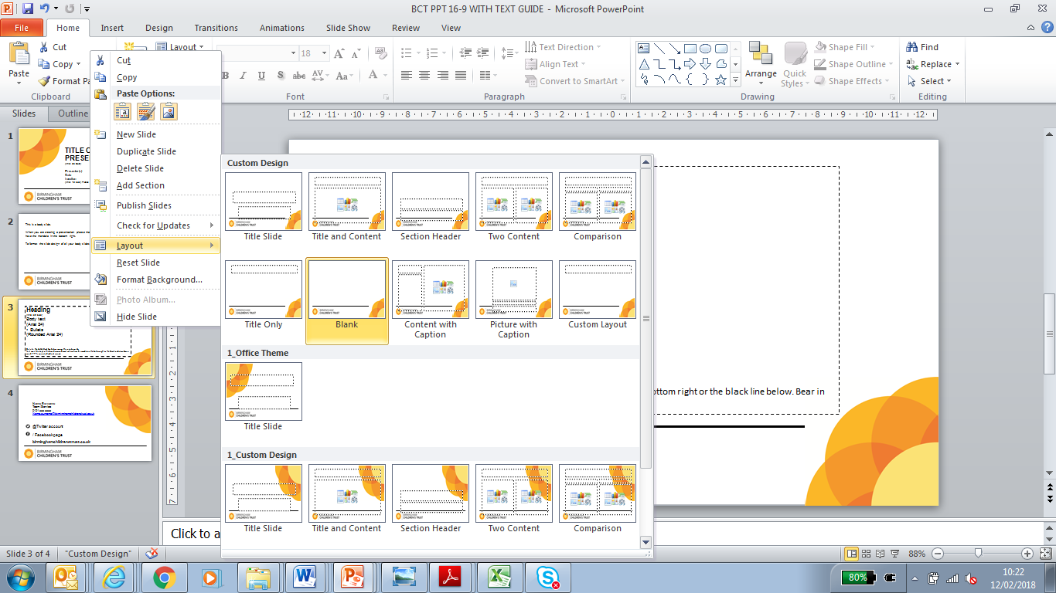
This is a body slide.
When you are creating a presentation please make sure all your body slides have the mandala in the bottom right.
To format the slide design of all your body slides to have this design
highlight all your body slides
Right click on your mouse
Scroll down to Layout
Select this layout
All the highlighted slides will now have this body layout.
Remember do not highlight the last slide. This will have your contact details.
THIS IS A GUIDANCE SLIDE
PLEASE DELETE IN FULL FROM YOUR PRESENTATION

Slide 5
Heading
(Arial 28 bold)
Body text
(Arial 16 minimum)
Bullets
(Keep bullets rounded as above)
Text must be kept in this boxed area, and must not run over the mandala in the bottom right or the black line below. Bear in mind PPT is a visual aid and not a script.

Slide 6


Name Surname
Team /Service
0121 xxx xxxx
Name.surname@birminghamchildrenstrust.co.uk
@Twitter account
/ Facebook page
(NOTE – All social media info above is OPTIONAL – it can be deleted if not needed – including the icons)
birminghamchildrenstrust.co.uk

